Slide 1
Building an Image Classifier

Slide 2
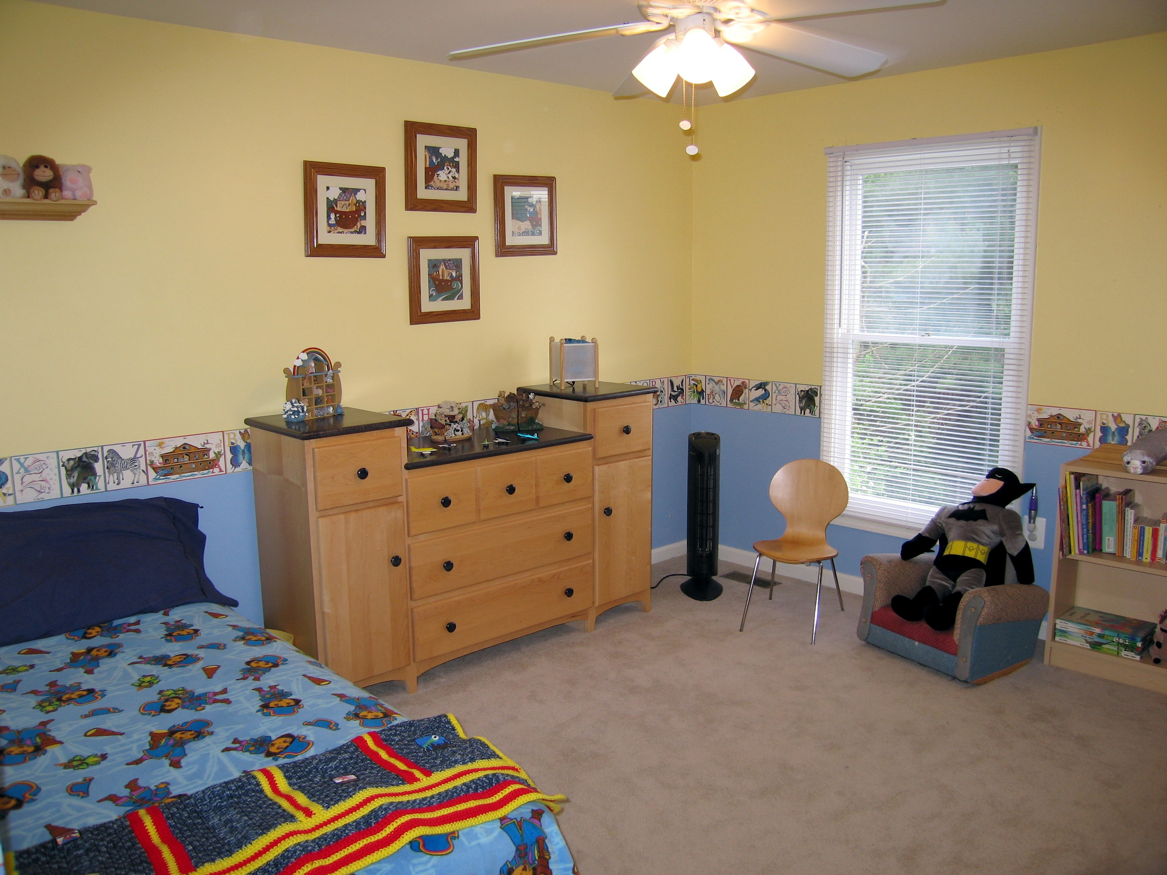
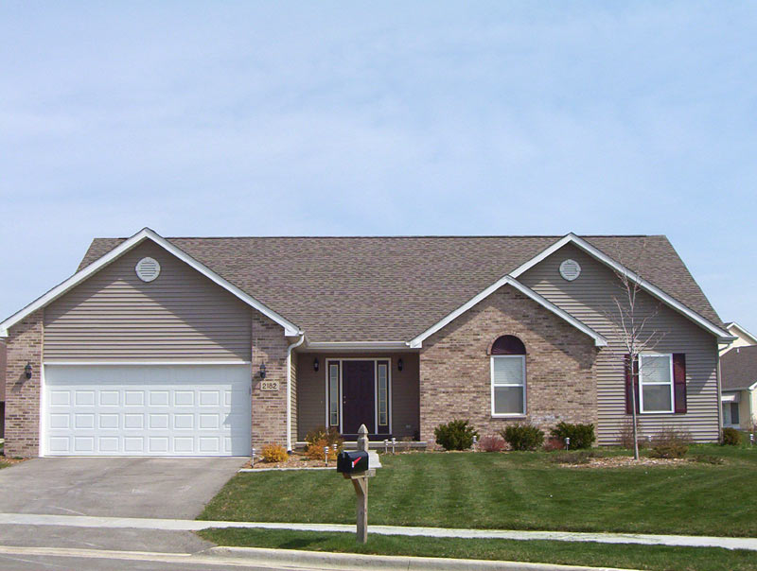
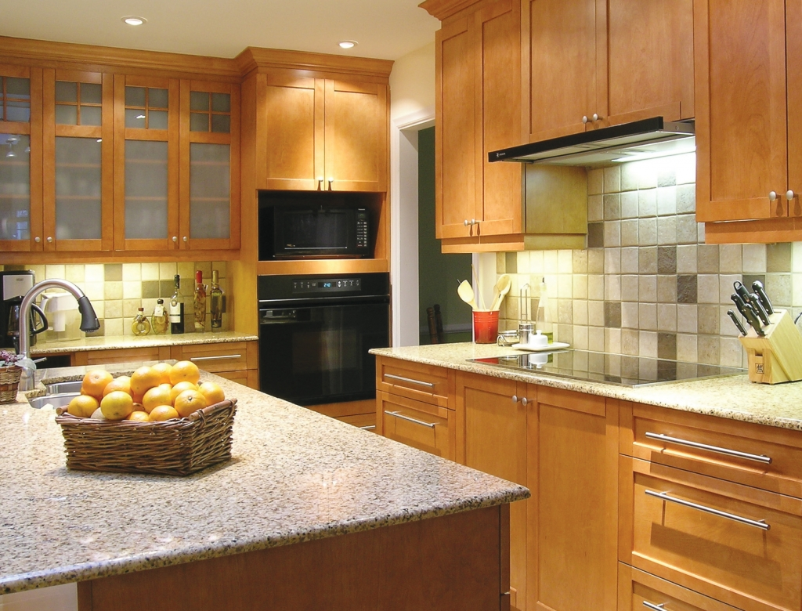

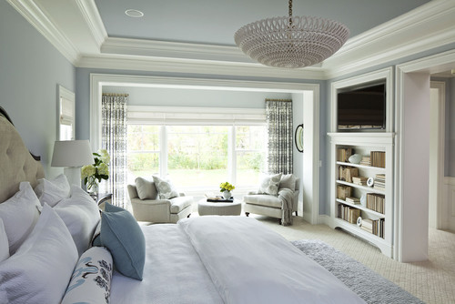
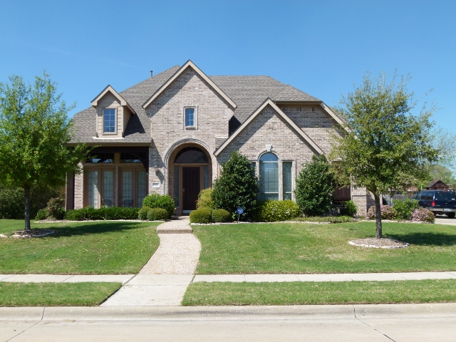
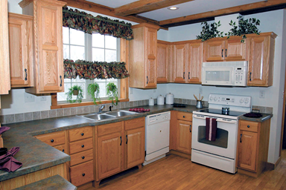
Bedroom
Kitchen

Slide 3
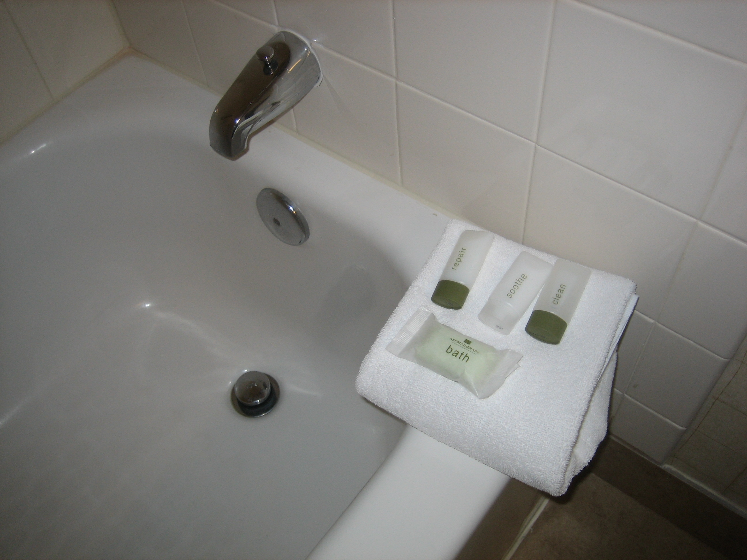
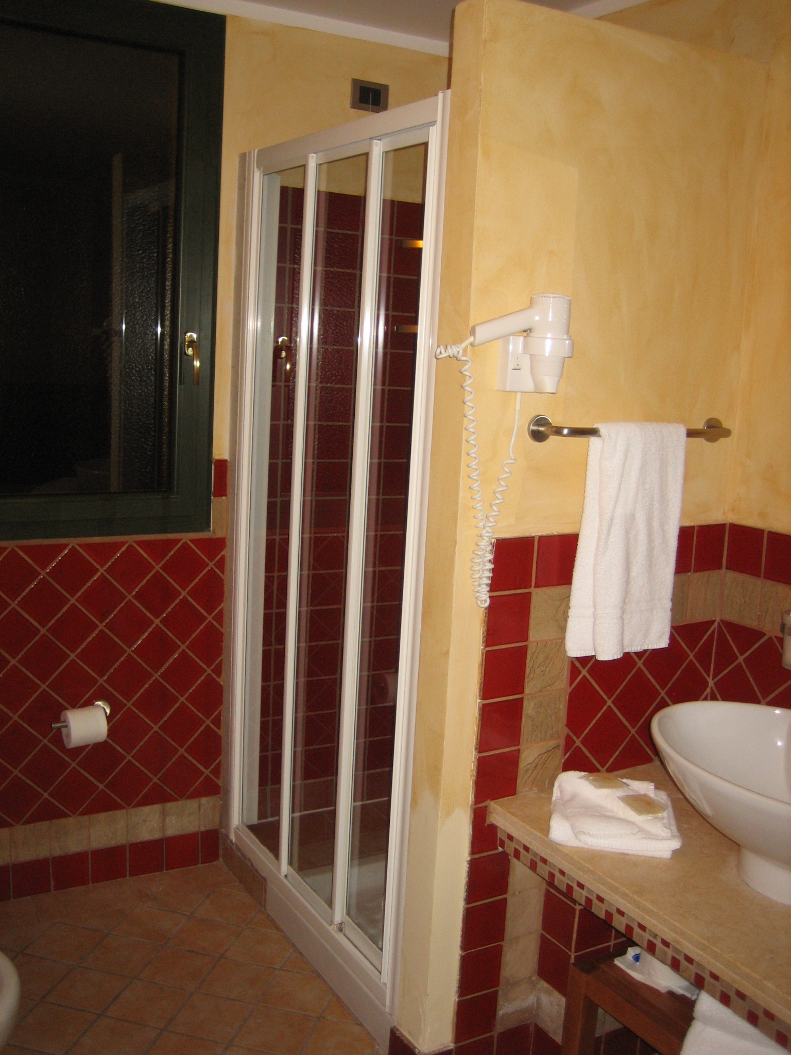
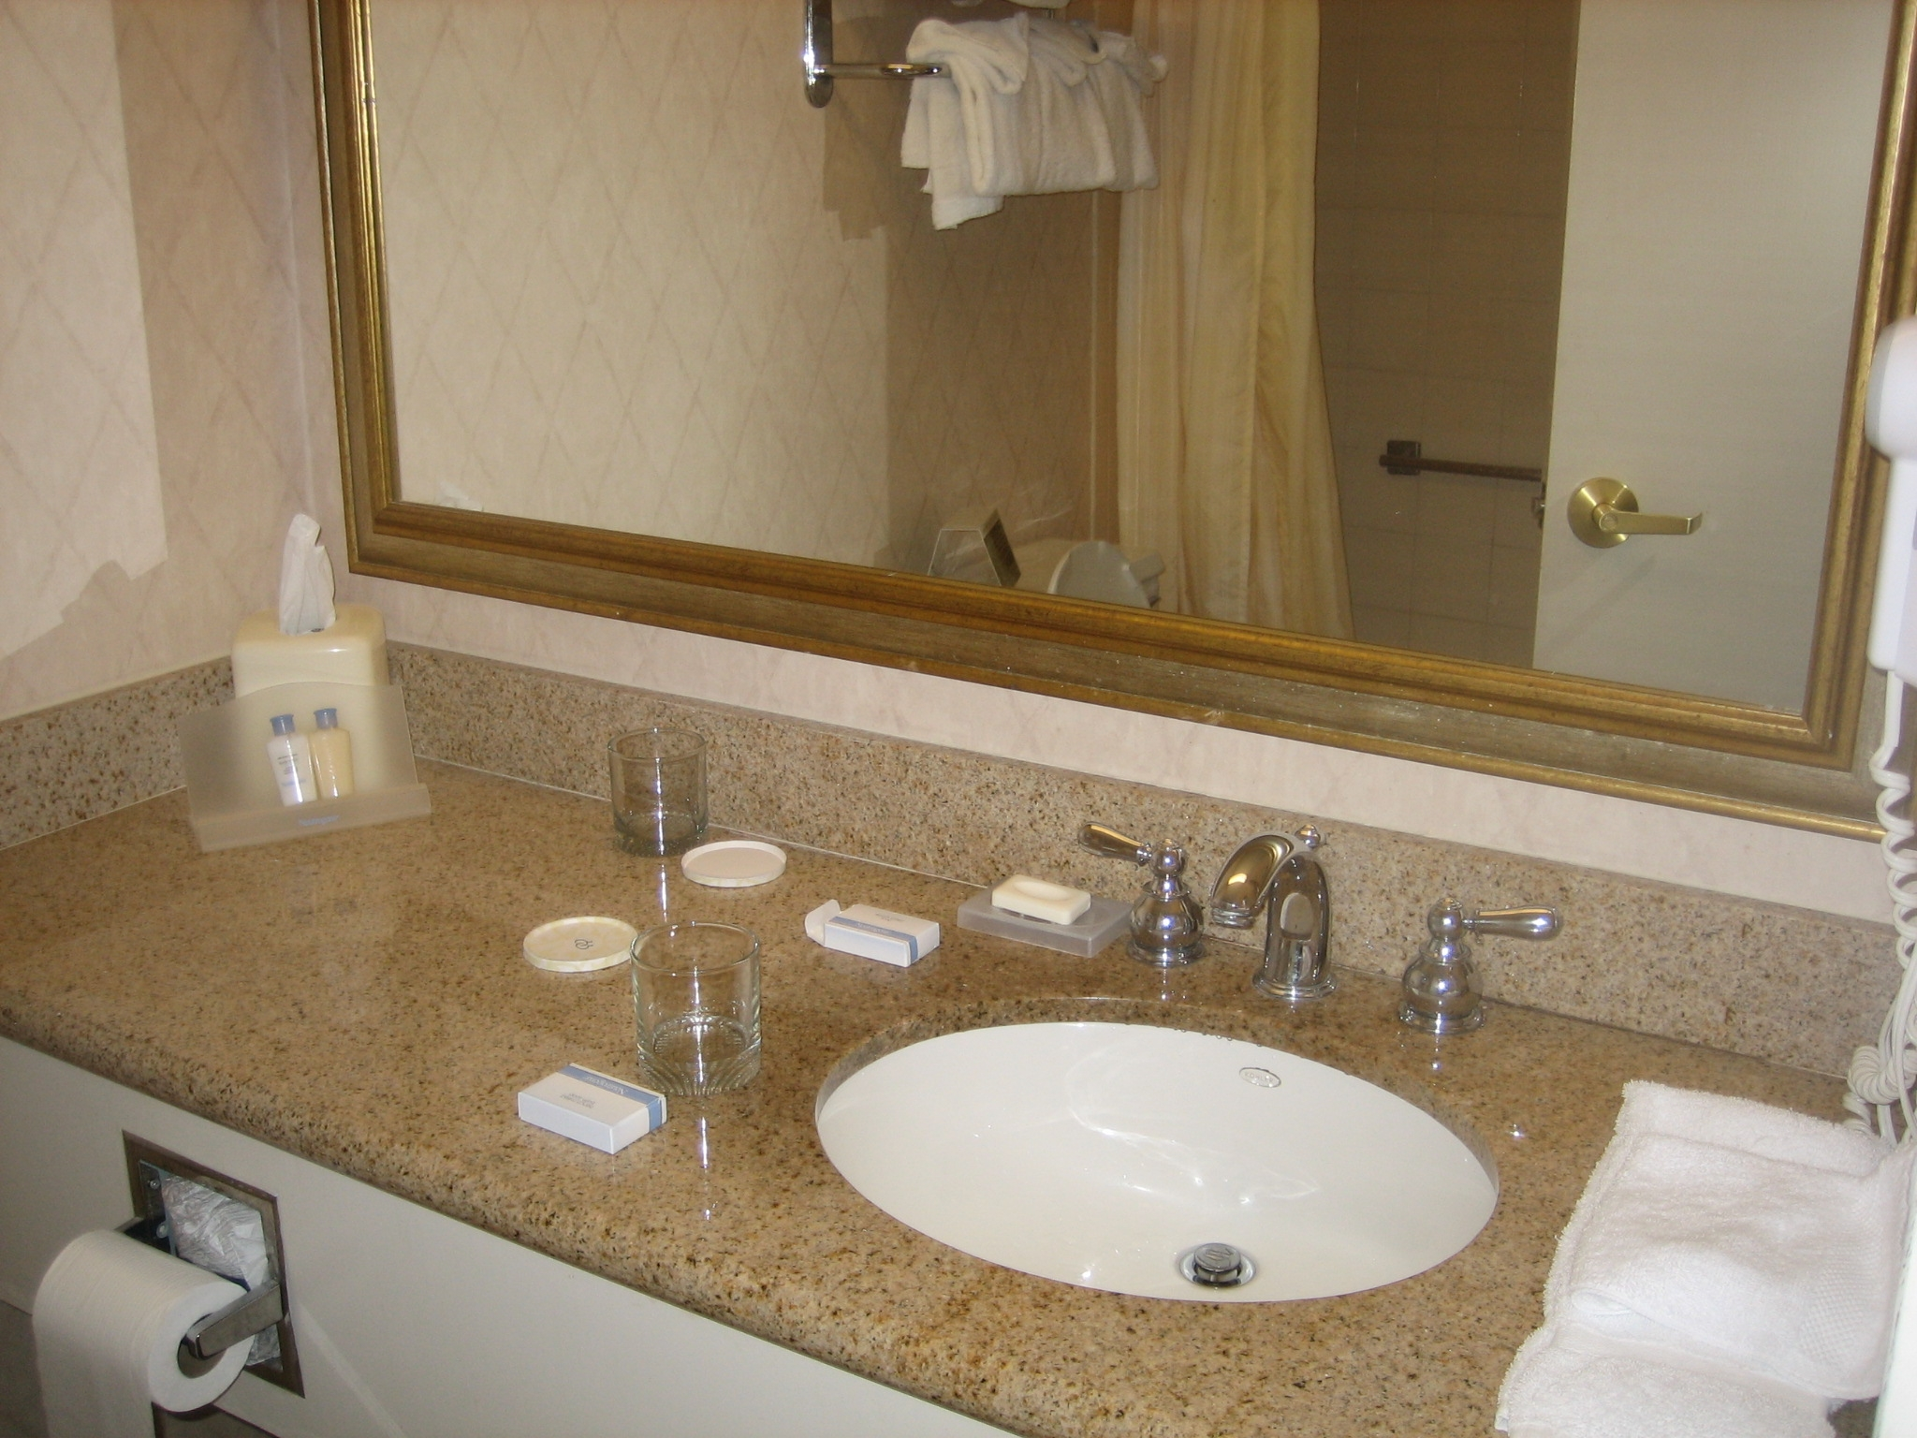
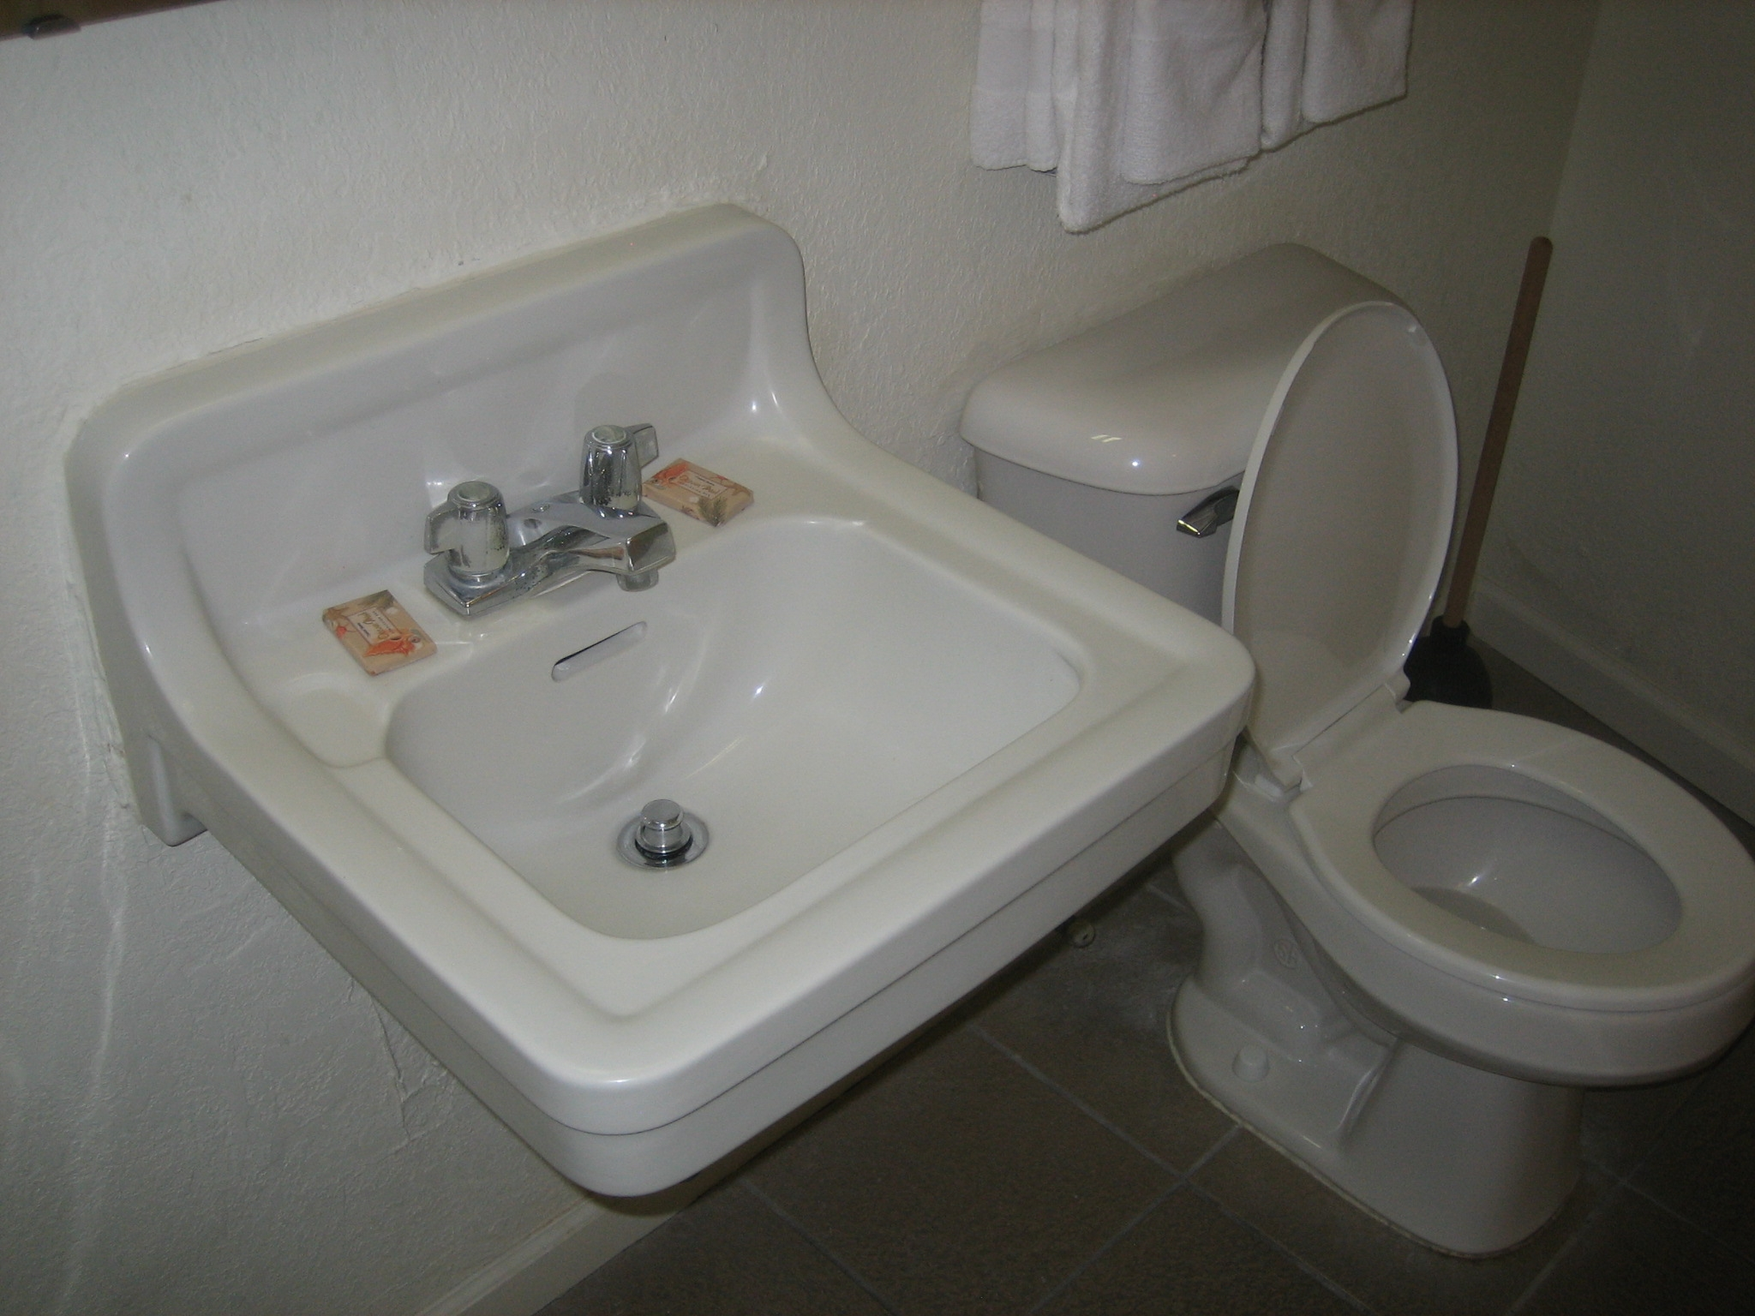
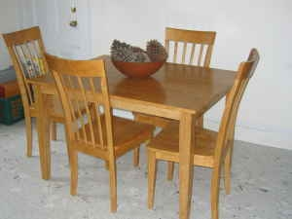
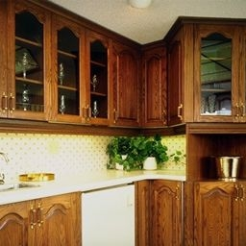
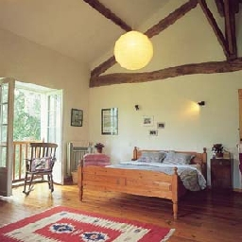
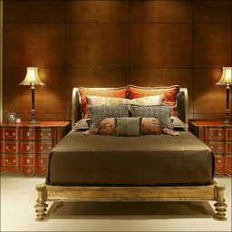
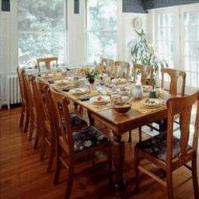
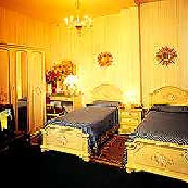
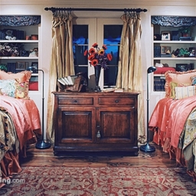
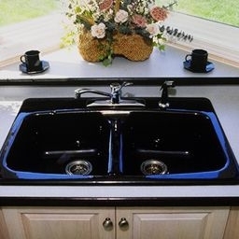
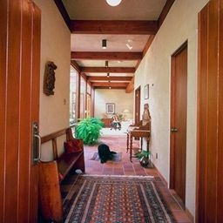

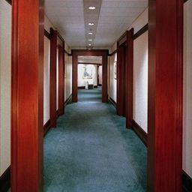
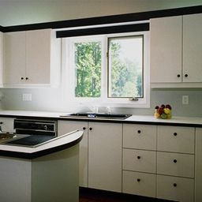
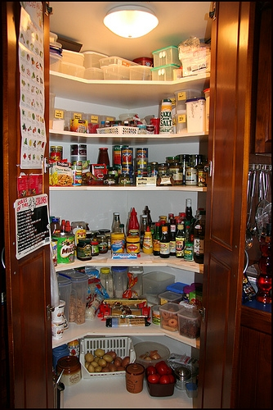
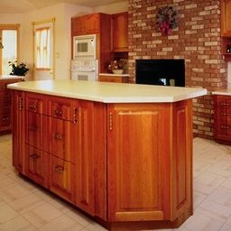
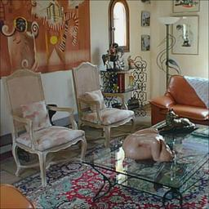
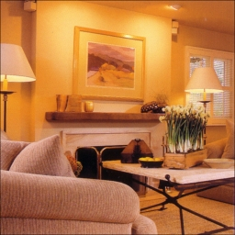
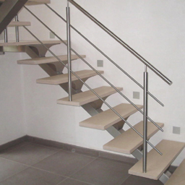
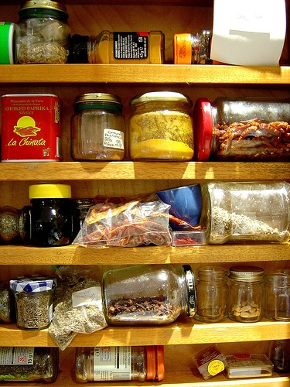

Slide 4
Train
Images
Feature Extraction
InceptionV3
Image net Weights
Test
Images
Bottleneck Layer
Logistic
Regression
Support
Vector Machine
Random Forest
XGBoost
Optimized
Logistic
Optimized
SVM
Optimized
Random Forest
Optimized
XGBoost
Model Evaluation
Accuracy
Precision
Recall
F1
Confusion

Slide 5
How did the models perform?

Slide 6
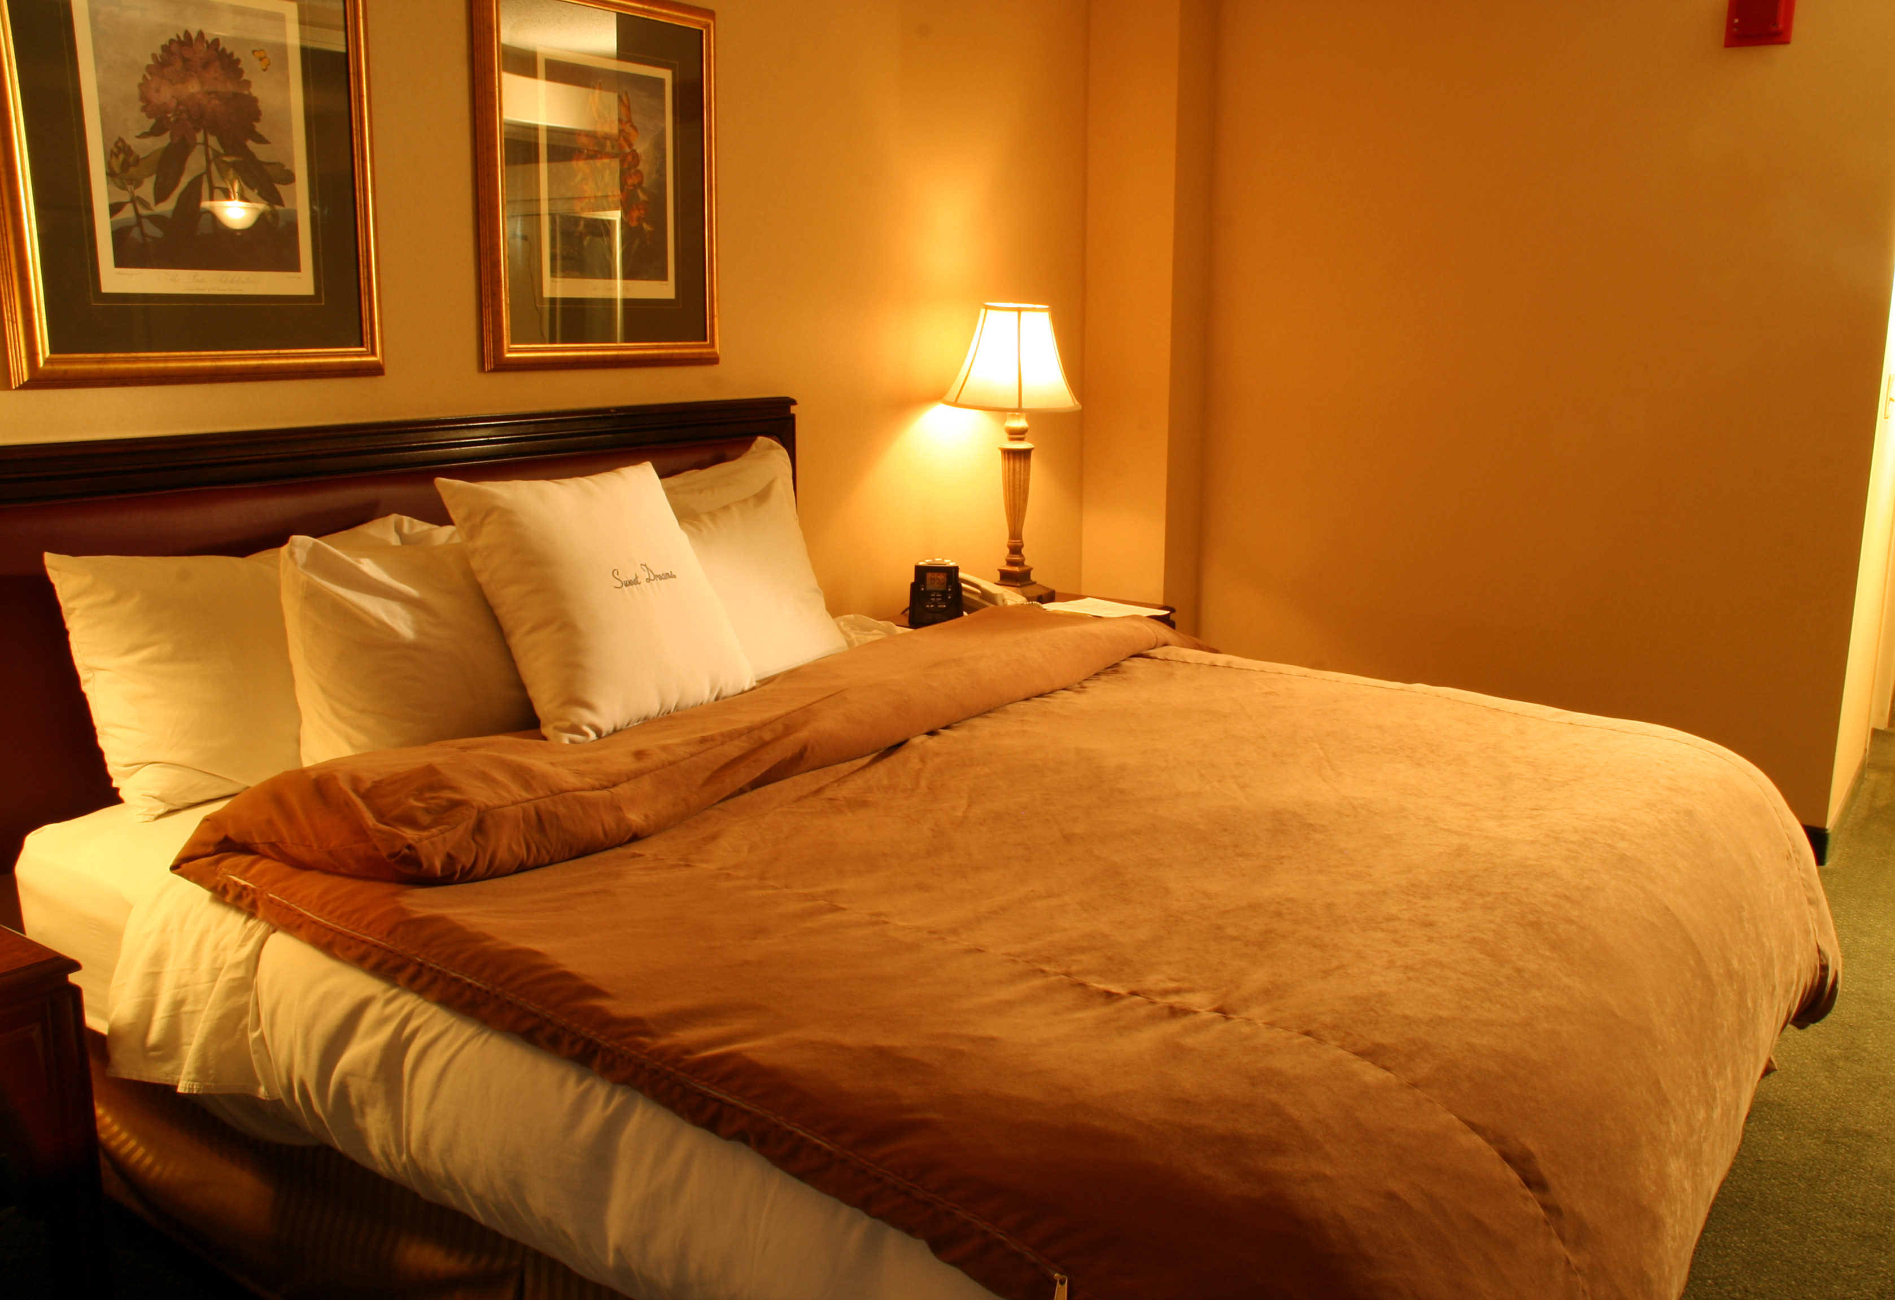

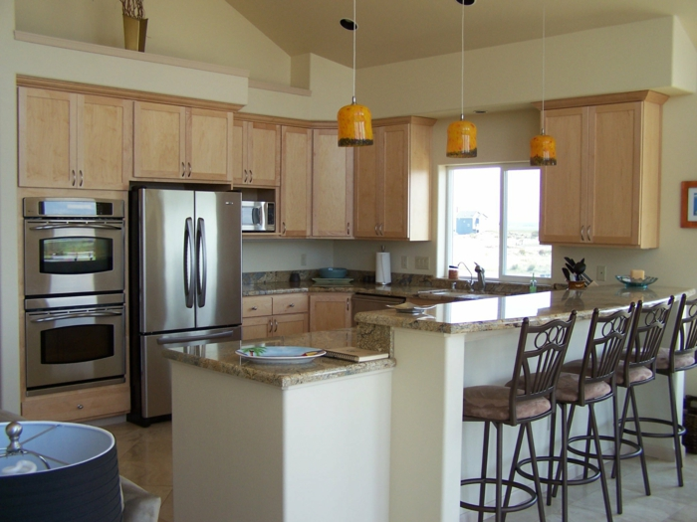
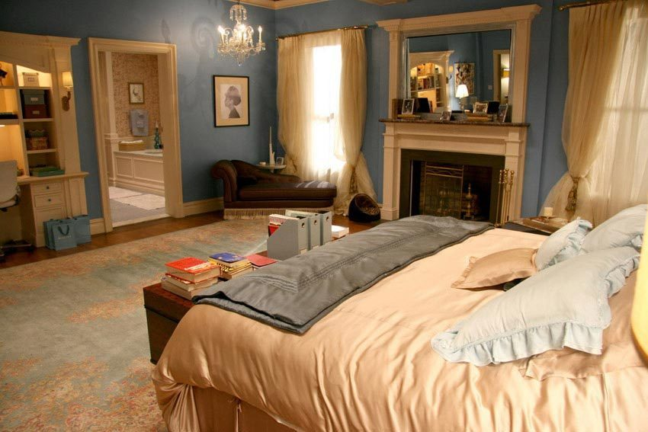

Accuracy
Bedroom
3/6
Model
Kitchen

Slide 7
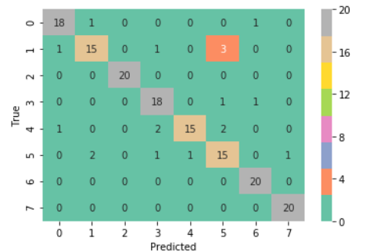
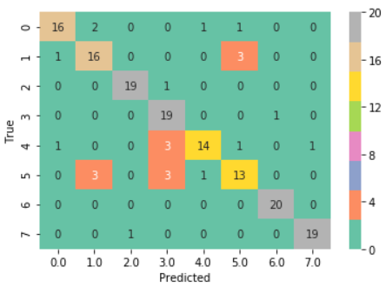
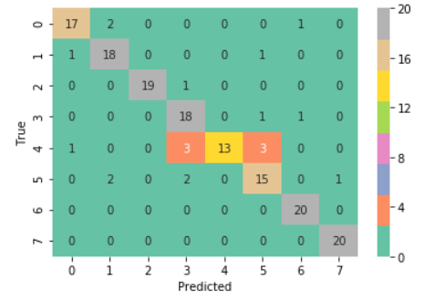
Logistic
Random Forest
0 | bathroom
1 | bedroom
2 | corridor
3 | Dining room
4 | kitchen
5 | Living room
6 | pantry
7 | staircase
Support Vector
XGBOOST

Slide 8
Accuracy
 | Logistic | Random Forest | Support Vector | XGBOOST
 | 0.881 | 0.875 | 0.875 | 0.850

Slide 9
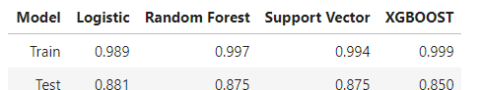
Over Fitting

Slide 10
Precision
Bedroom
2/4
Model
Kitchen
1/2

Slide 11
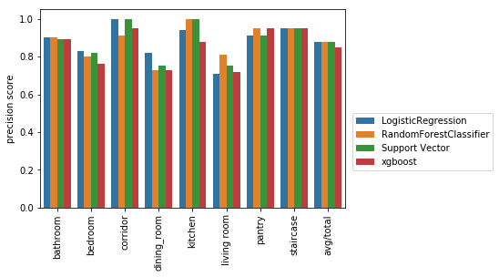
Precision

Slide 12
RECALL
Bedroom
2/3
Model
Kitchen
1/3

Slide 13
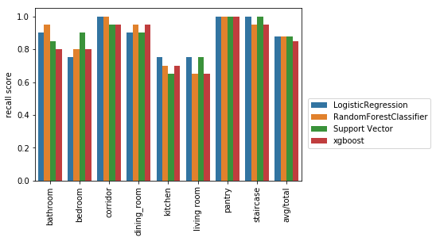
RECALL

Slide 14
F1- Score
Harmonic Average of Precision and Recall
Precision
Recall

Slide 15
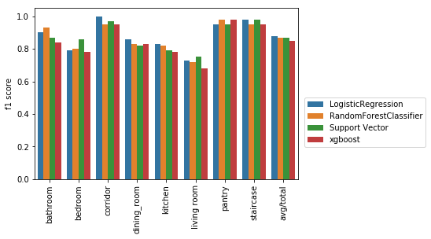

Slide 16
Some Incorrectly labelled Images

Slide 17
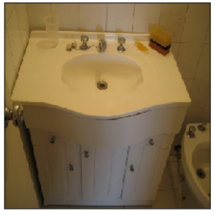
Logistic | Random Forest | Support Vector | XGBOOST
pantry | bathroom | pantry | kitchen

Slide 18
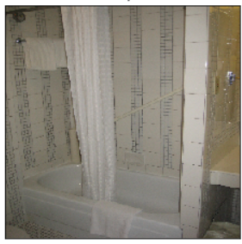
Logistic | Random Forest | Support Vector | XGBOOST
Bedroom | Bedroom | Bedroom | Bedroom

Slide 19
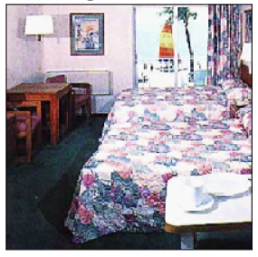
Logistic | Random Forest | Support Vector | XGBOOST
Living Room | Dining Room | Living Room | Living Room

Slide 20
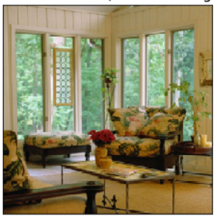
Logistic | Random Forest | Support Vector | XGBOOST
StairsCase | Corridor | Stairscase | Diningroom

Slide 21
What Next:
Extract features from a deeper layer of the neural network
Evaluate other neural networks for feature extraction
More insight into the classification process : LIME
Increase number of images.

